Slide 1
Impact of COVID-19 on Students' Education, Social Life, and Mental Health
A survey analysis.

Slide 2
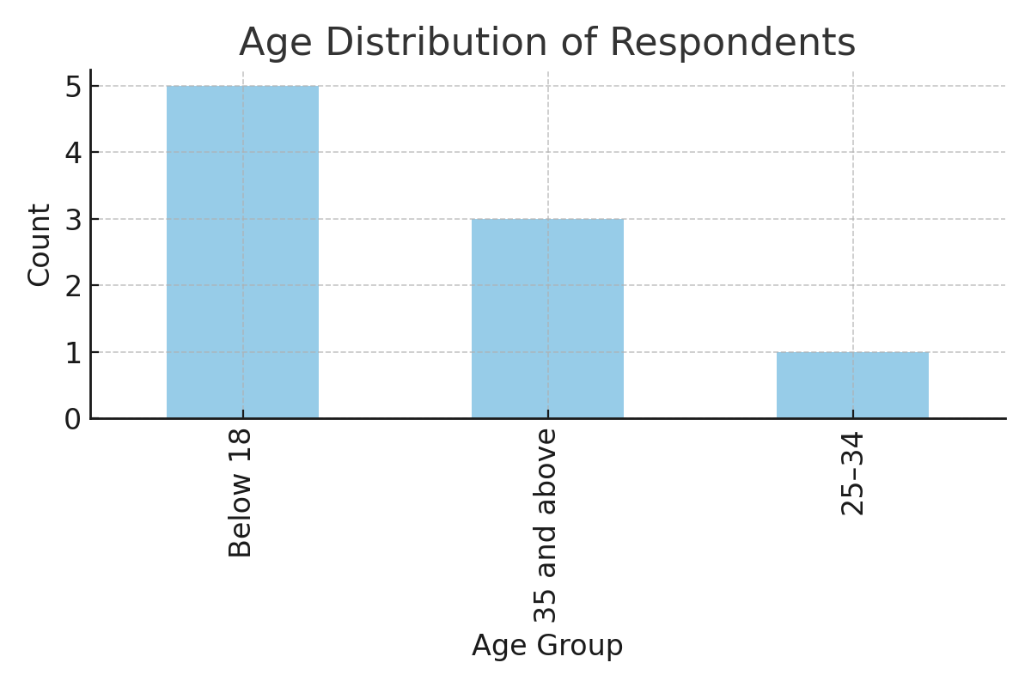
Age Distribution of Respondents

Slide 3
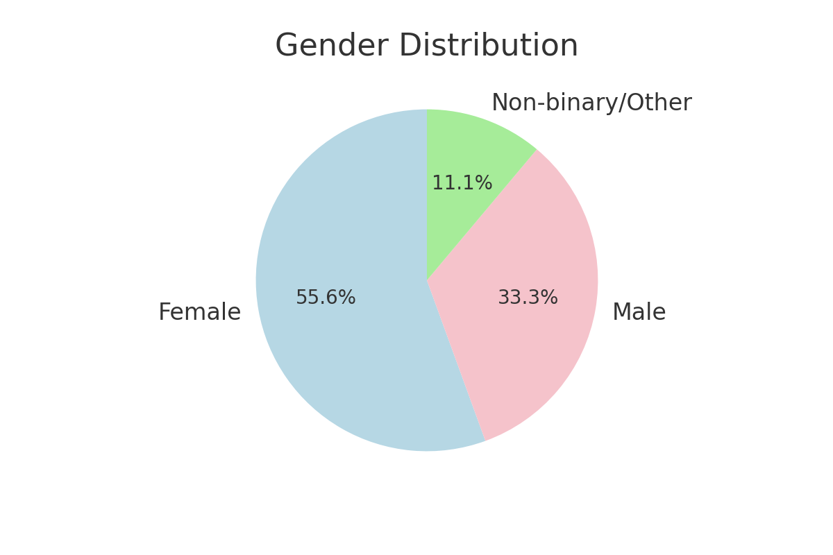
Gender Distribution

Slide 4
Education Levels of Respondents
High School: 4
Postgraduate: 3
Other: 1
Undergraduate: 1

Slide 5
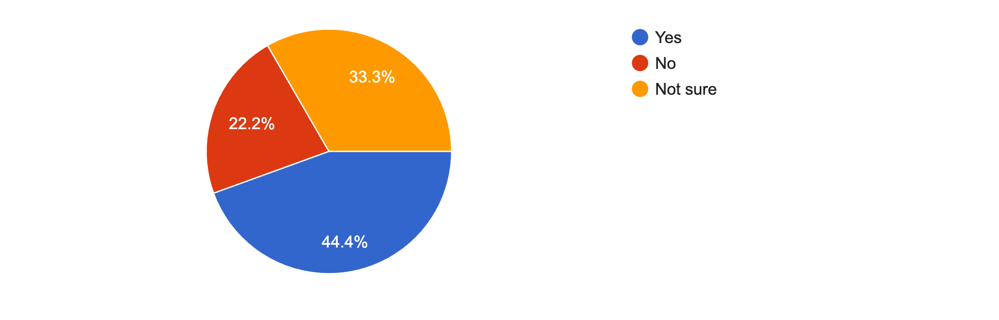
Do you believe the pandemic has impacted your future career plans?

Slide 6
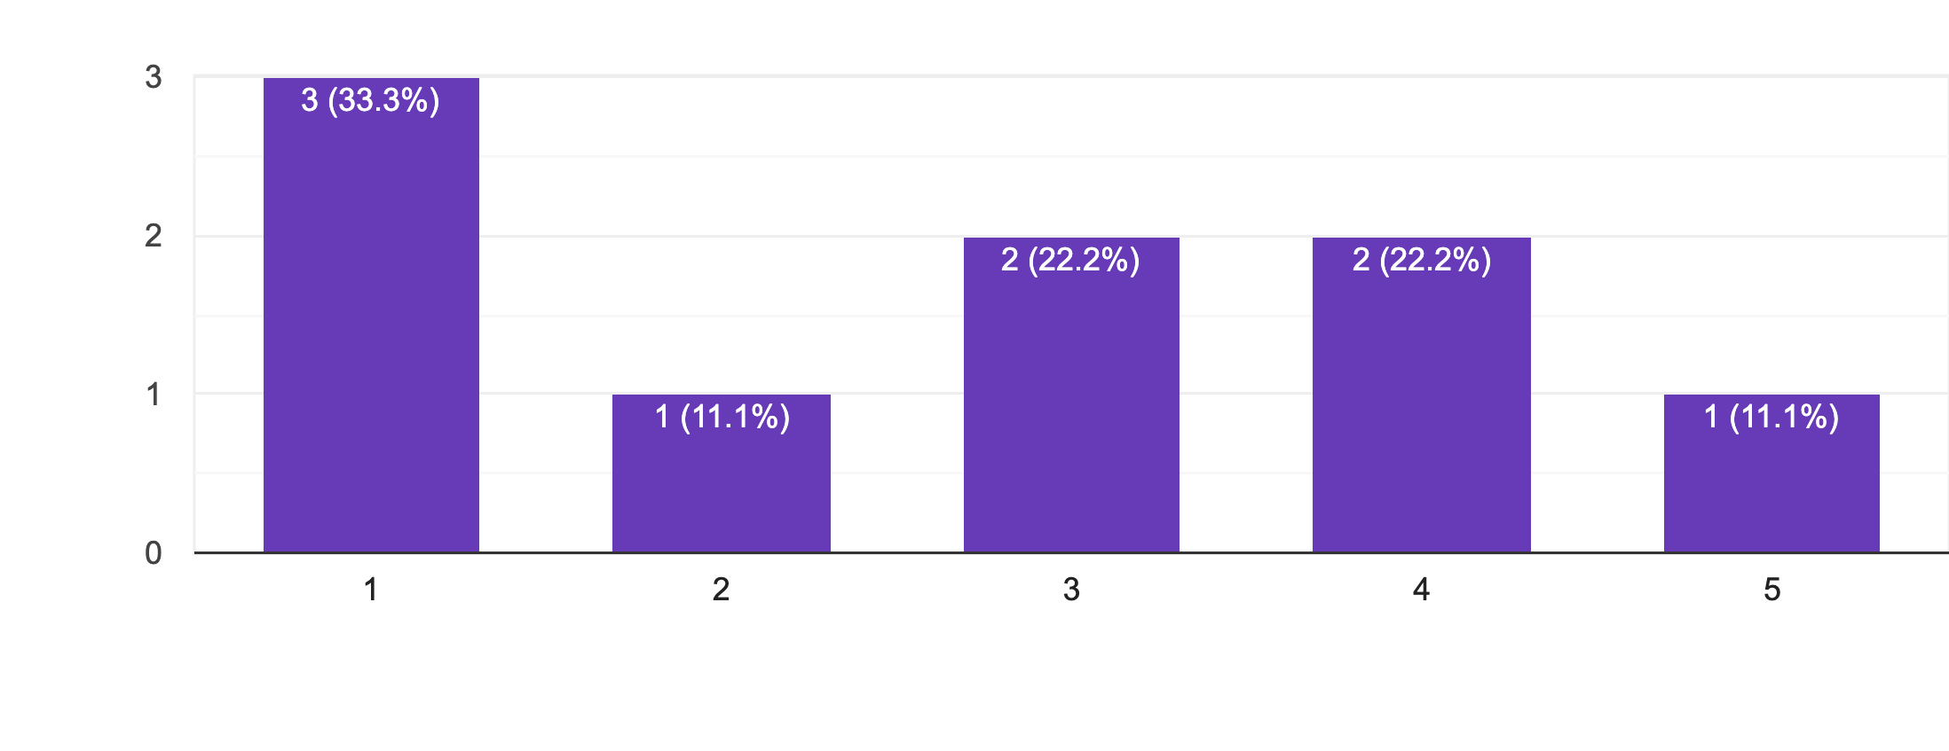
Did you experience an increase in stress or anxiety during the pandemic?

